Slide 1
Jenkins Setup Documentation
Gary Hsu

Slide 2
Outline
Prerequisites
Setup
Start/Stop/Restart
Manage Jenkins
Manage Plugins

Slide 3
PreRequisites
Ubuntu
Distributor ID: Ubuntu
Description: Ubuntu 16.04.3 LTS
Release: 16.04
Codename: xenial
Java OpenSDK
openjdk version "1.8.0_131"
OpenJDK Runtime Environment(build 1.8.0_131-8u131-b11-2ubuntu1.16.04.3-b11)
OpenJDK 64-Bit Server VM (build 25.131-b11, mixed mode)

Slide 4
Setup
Installation
$wget -q -O - https://pkg.jenkins.io/debian/jenkins-ci.org.key | sudo apt-key add –
$sudo sh -c 'echo deb http://pkg.jenkins.io/debian-stable binary/ > /etc/apt/sources.list.d/jenkins.list‘
$sudo apt-get update
$sudo apt-get install jenkins
Upgrade
$sudo apt-get update
$sudo apt-get install –y jenkins

Slide 5
Setup
Create 'system' account for 'jenkins'
Add 'system' user
$ sudo adduser system
Add user = 'jenkins' to group = 'system'
$sudo usermod -a -G system jenkins

Slide 6
Setup
Jenkins will be launched as a daemon up on start. See /etc/init.d/jenkins for more details.
The 'jenkins' user is created to run this service.
Log file will be placed in /var/log/jenkins/jenkins.log. Check this file if you are troubleshooting Jenkins.
/etc/default/jenkins will capture configuration parameters for the launch like e.g JENKINS_HOME
$sudo vim /etc/default/jenkins
JENKINS_HOME=/home/system/jenkins_workspace
Save file
Reference from: https://wiki.jenkins.io/display/JENKINS/Installing+Jenkins+on+Ubuntu

Slide 7
Start/Stop/Restart
Start
$sudo service jenkins start
Stop
$sudo service jenkins stop
Restart
$sudo service jenkins restart

Slide 8
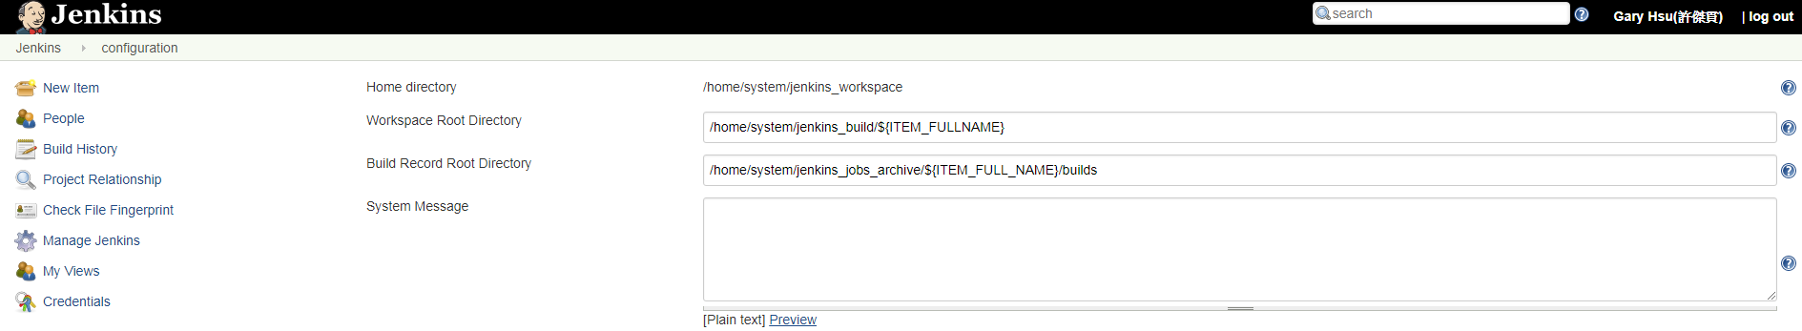
Manage Jenkins – Workspace Setting
Manage Jenkins -> Config System
Home directory (jenkins setting)
/home/system/jenkins_workspace
Workspace Root Directory (Job building step workspace) /home/system/jenkins_build/${ITEM_FULLNAME}
Build Record Root Directory (Job build result) /home/system/jenkins_jobs_archive/${ITEM_FULL_NAME}/builds

Slide 9
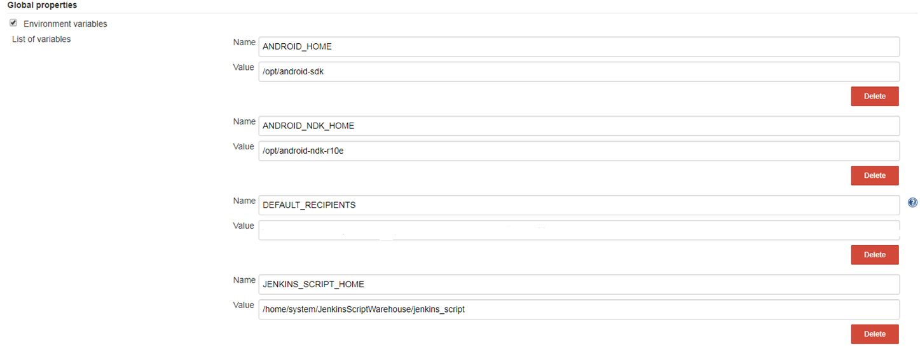
Manage Jenkins – Global Properties
Add global variable for job build useage

Slide 10
Manage Jenkins – Email Setting
System Admin e-mail address: admin address setting as following

Slide 11
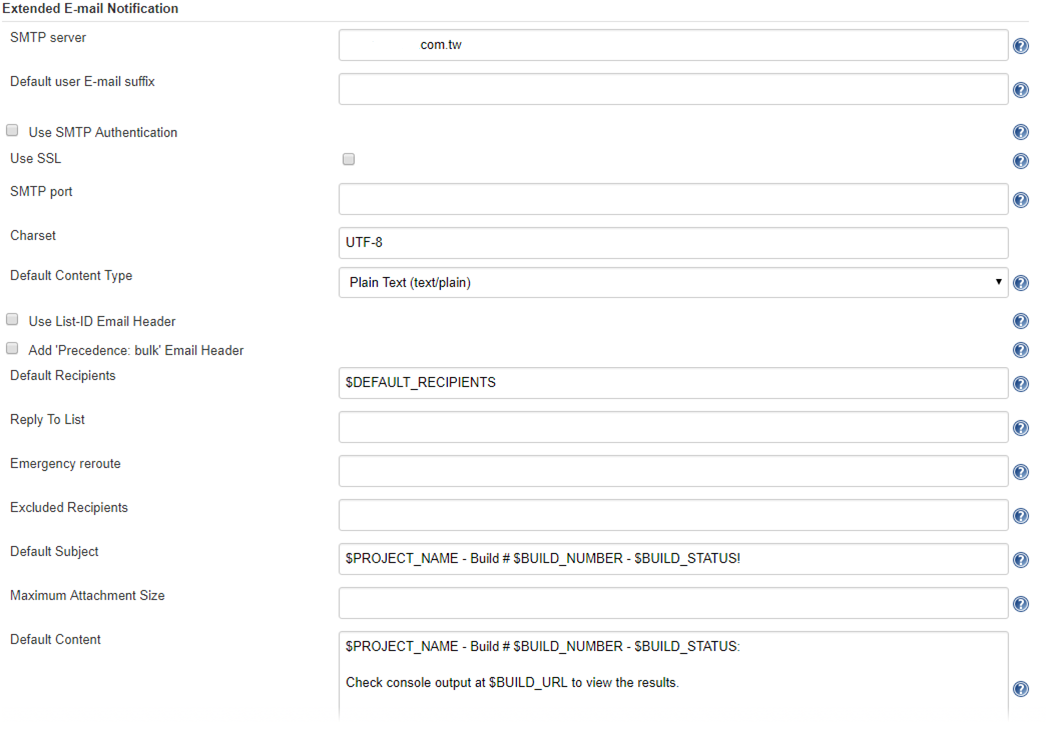
Manage Jenkins – Email Setting
SMTP server : Your SMTP Server
DEFAULT_RECIPIENTS: Team member

Slide 12
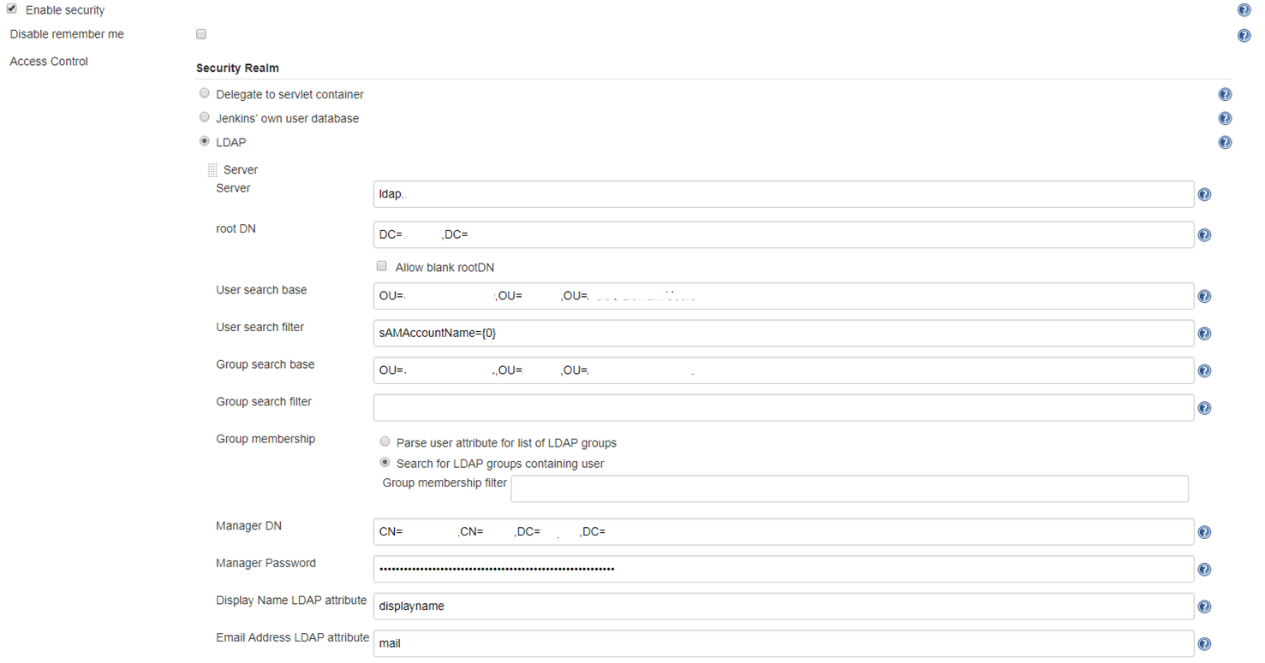
Manage Jenkins - Secure login with LDAP

Slide 13
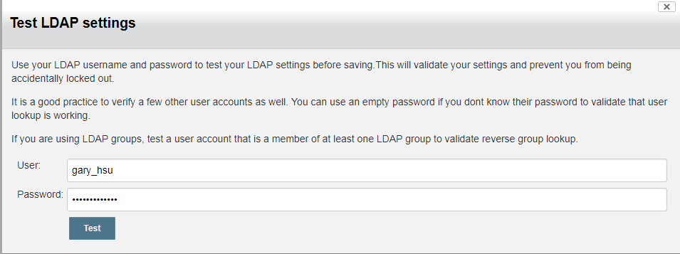
Manage Jenkins - Test login with LDAP
Manage Jenkins -> Config Global Security
Enable security -> Access Control -> LDAP

Slide 14
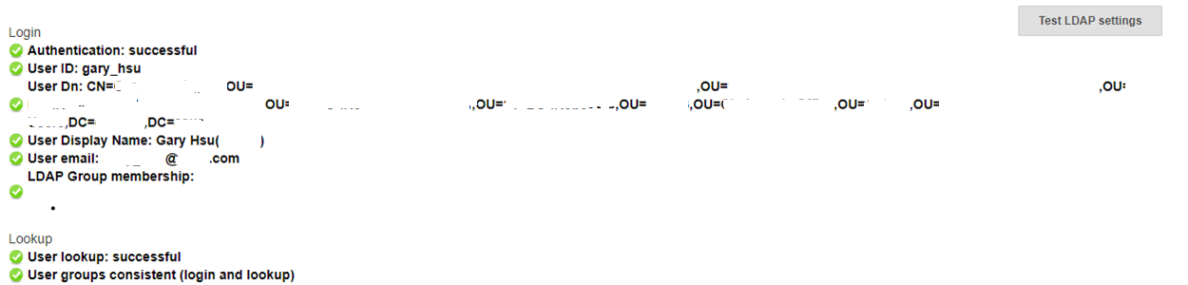
Manage Jenkins - Test login with LDAP
Manage Jenkins -> Config Global Security
Enable security -> Access Control -> LDAP

Slide 15
Manage Plugins
Manage Jenkins -> ManagePlugins
Gradle Plugin
LDAP Plugin
Git Client Plugin
Environment Injector Plugin

Slide 16
Reference
Jenkins Official: https://jenkins.io/
StackOverlow

